Slide 1

Functions and Forms
f(x)
SoftUni Team
Technical Trainers
Software University
http://softuni.bg

Slide 2
Table of Content
PHP Functions
Declaring/Invoking
Parameters, Returning Values
Anonymous functions
Naming and Best Practices
Forms
Definition
Handling

Slide 3
Have a Question?
sli.do
#tech-fund

Slide 4

PHP Functions
User-defined Functions

Slide 5
Functions in PHP
In PHP we have two type of functions:
User-defined Function: is the function created by user
Built-in Function: is the function created by PHP, and ready to use
Key word
Function name
function sayHello()
{ // Some Code }
Function
body
$input = readline();
$num = intval($input);

Slide 6
Why Use Functions?
More manageable programming
Splits large problems into small pieces
Better organization of the program
Improves code readability
Improves code understandability
Avoiding repeating code
Improves code maintainability
Code reusability
Using existing functions several times

Slide 7
{…}
Declaring and Invoking Functions
Notes:
Add Image!

Slide 8
Declaring Function
Function name
(camelCase)
Key word
Parameters
void function not return any value
function printText($text) : void
{
echo $text;
}
Function Body
Every reusable function has a name and type(optional)
Functions can have several parameters
It is possible for function to not return a value

Slide 9
Invoking a Function
Functions are first declared, then invoked (many times)
Functions can be invoked (called) by their name:
function printName()
{
echo "Peter";
}
Function Declaration
<?php
printName();
// Peter
Function Invocation

Slide 10
Invoking a Function (2)
A function can be invoked from:
Inside the PHP tag(<?php)
<?php
printName();
Its own body - recursion
Other functions
function crash()
{
crash();
}
function printPersonInfo()
{
printName();
printAge();
}
Function invoking itself
Function invoking functions

Slide 11
$
Functions with Parameters

Slide 12
Parameters
To pass an information to a function, you can use parameters(arguments)
Arguments are specified after the function name, inside the parentheses
You can have zero or several arguments
Each parameter has a name
You can set default value

Slide 13
Function Parameters (1)
Function with parameters
Call the function with certain values (arguments)
function printPersonInfo($name, $age)
{
echo "$name is $age years old";
}
Multiple parameters separated by comma
<?php
printPersonInfo("Peter", 18);
//Peter is 18 years old
Passing arguments at invocation

Slide 14
Function Parameters (2)
Function with default value of parameters
function printNumbers($start = 1, $end = 5)
{
for ($i = $start; $i <= $end; $i++)
echo $i . ' ';
}
<?php
printNumbers(); //1 2 3 4 5
printNumbers(10, 14); //10 11 12 13 14
printNumbers(null, null); //{empty}

Slide 15
Problem: Sign of Integer Number
Create a function that prints the sign of an integer number n:
2
The number 2 is positive.
-5
The number -5 is negative.
0
The number 0 is zero.
Check your solution here: https://judge.softuni.bg/Contests/1200/

Slide 16
Solution: Sign of Integer Number
<?php
$number = intval(readline());
function printSign($number) {
if ($number > 0)
$result = "The number $number is positive.";
else if ($number < 0)
$result = "The number $number is negative.";
else
$result = "The number $number is zero.";
echo $result;
}
printSign($number);
Check your solution here: https://judge.softuni.bg/Contests/1200/

Slide 17
Problem: Grades
Write a function that receives a grade between 2.00 and 6.00 and prints the corresponding grade in words
2.00 - 2.99 - "Fail"
3.00 - 3.49 - "Poor"
3.50 - 4.49 - "Good"
4.50 - 5.49 - "Very good"
5.50 - 6.00 - "Excellent"
3.33
Poor
4.50
Very good
2.99
Fail
Check your solution here: https://judge.softuni.bg/Contests/1200/

Slide 18
Solution: Grades
$grade = floatval(readline());
printInWords($grade);
function printInWords($grade) {
$gradeInWords = '';
if ($grade >= 2 && $grade <= 2.99)
$gradeInWords = "Fail";
//TODO: make the rest
echo $gradeInWords;
}
Check your solution here: https://judge.softuni.bg/Contests/1200/

Slide 19
Problem: Printing Triangle
Create a function for printing triangles as shown below:
1
1 2
1 2 3
1 2 3 4
1 2 3
1 2
1
1
1 2
1 2 3
1 2
1
3
4
Check your solution here: https://judge.softuni.bg/Contests/1200/

Slide 20
Solution: Printing Triangle
Create a function that prints a single line, consisting of numbers from a given start to a given end:
function printLine($start, $end) {
for ($i = $start; $i <= $end; $i++) {
echo "$i ";
}
echo PHP_EOL;
}
Check your solution here: https://judge.softuni.bg/Contests/1200/

Slide 21
Solution: Printing Triangle (2)
Create a function that prints the first half (1..n) and then the second half (n-1…1) of the triangle:
Function with parameter n
function printTriangle($n) {
for ($line = 1; $line <= $n; $line++)
printLine(1, $line);
for ($line = $n - 1; $line >= 1; $line--)
printLine(1, $line);
}
printTriangle(intval(readline()));
Lines 1...n
Lines n-1…1
Check your solution here: https://judge.softuni.bg/Contests/1200/

Slide 22

Live Exercises

Slide 23
Returning Values From Functions

Slide 24
The Return Statement
The return keyword immediately stops the function's execution
Returns the specified value
Optional set return type: int, float, string, bool, array and etc.
function readFullName() : string
{
$firstName = readline(); //John
$lastName = readline(); //Smith
return "$firstName $lastName";
}
echo readFullName(); //John Smith

Slide 25
Using the Return Values
Return value can be:
Assigned to a variable
Used in expression
Passed to another function
$max = getMax(5, 10);
$total = getPrice() * quantity * 1.20;
$age = intval(readline());

Slide 26
Problem: Calculate Rectangle Area
Create a function which returns rectangle area with given width and height
3
4
6
8
12
48
5
10
7
8
50
56
Check your solution here: https://judge.softuni.bg/Contests/1200/

Slide 27
Solution: Calculate Rectangle Area
<?php
$width = floatval(readline());
$height = floatval(readline());
function calcRectangleArea($width, $height) :float
{
return $width * $height;
}
$area = calcRectangleArea($width, $height);
echo $area;
Check your solution here: https://judge.softuni.bg/Contests/1200/

Slide 28
Problem: Repeat String
Write a function that receives a string and a repeat count n
The function should return a new string
abc
3
abcabcabc
String
2
StringString
Check your solution here: https://judge.softuni.bg/Contests/1200/

Slide 29
Solution: Repeat String
$inputStr = readline();
$count = intval(readline());
echo repeatString($inputStr, $count);
function repeatString($str, $count) {
$result = "";
for ($i = 0; $i < $count; $i++)
$result .= $str;
return $result;
}
Check your solution here: https://judge.softuni.bg/Contests/1200/

Slide 30
Problem: Math Power
Create a function that calculates and returns the value of a number raised to a given power
2⁸
256
3⁴
81
function mathPower($number, $power) {
$result = 1;
for ($i = 0; $i < $power; $i++)
$result *= $number;
return $result;
}
Check your solution here: https://judge.softuni.bg/Contests/1200/

Slide 31
Live Exercises

Slide 32
function () {
}
Anonymous Functions

Slide 33
Anonymous Functions
Function without name
Using for:
Assign it to a variable, then call it later using the variable's name
Pass it to another function that can then call it later - callback
function ($name, $timeOfDay) {
return "Good $timeOfDay, $name!";
};

Slide 34
Assigning anonymous function to variable
Define an anonymous function, then store it in a variable, just like any other value
$result = function ($name, $timeOfDay) {
return "Good $timeOfDay, $name!";
};
echo $result("George", "night");
//Good night, George!

Slide 35
Using anonymous functions as callbacks
A callback function is a function that pass to another function as an argument
Many built-in PHP functions accept callbacks
$names = ["Peter", "George", "John"];
print_r(array_map(function ($name) {
return "Hello $name!";
}, $names));
//Hello Peter!
//Hello George!
//Hello John!
Callback function

Slide 36
Problem: Factorial
Write an assigning anonymous function that calculate n factorial and return it
1
1
5
120
25
15511210043330985984000000
Check your solution here: https://judge.softuni.bg/Contests/1200/

Slide 37
Solution: Factorial
<?php
$n = intval(readline());
$factorial = function ($n) {
$factorial = 1;
for ($i = 1; $i <= $n; $i++)
$factorial = bcmul($factorial, $i);
return $factorial;
};
printf("%s", $factorial($n));
Check your solution here: https://judge.softuni.bg/Contests/1200/

Slide 38

Variables Scope

Slide 39
The Global Keyword
Variables outside of a function are not accessible in it:
To access an external variable use the global keyword
$a = "test"; // global scope
function foo() {
echo $a; // Undefined variable: a (local scope)
}
foo();
$a = "test";
function foo() {
global $a; // the global variable $a is included in the scope
echo $a; // test
}
foo();

Slide 40
Loops and Variable Scope
Variables, declared in loops are accessible after the loop ends
A variable in PHP is declared with its first assignment
for ($i = 0; $i < 5; $i++) {
$arr[] = $i;
}
print_r($arr); // 0, 1, 2, 3, 4
$a = 15;
if ($a == 5) { $five = 'five'; }
else { $five = 'not five'; }
echo $five; // not five

Slide 41
Static Keyword
Static variables in PHP are initialized only once (on demand)
Their existing values are preserved in the next function calls
function callMe() {
static $count = 0; // initialized at the first call
$count++; // executed at each function call
echo "callMe() is called $count times" . PHP_EOL;
}
callMe(); // callMe() is called 1 times
callMe(); // callMe() is called 2 times

Slide 42

Naming and Best Practices

Slide 43


Naming Functions
Functions naming guidelines
Use meaningful function names
Should be in camelCase or with_underscores
Function names should answer the question:
What does this function do?
If you cannot find a good name for a function, think about whether it has a clear intent
averageGrade, delete_report, sine
Function1, DoSomething, handleStuff, DirtyHack

Slide 44
Naming Function Parameters
Function parameters names
Preferred form: [Noun] or [Adjective] + [Noun]
Should be in camelCase or with_underscores
Should be meaningful
Unit of measure should be obvious
first_name, report, speedKmH, users_list, fontSizeInPixels, font
p, p1, p2, populate, LastName, last_name, convertImage

Slide 45
Functions – Best Practices
Each function should perform a single, well-defined task
A Function's name should describe that task in a clear and non-ambiguous way
Avoid functions longer than one screen
Split them to several shorter functions
function printReceipt(){
printHeader();
printBody();
printFooter();
}
Self documenting and easy to test

Slide 46

Code Structure and Code Formatting
Make sure to use correct indentation
Leave a blank line between functions, after loops and after if statements
Always use curly brackets for loops and if statements bodies
Avoid long lines and complex expressions
function main(){
// some code…
// some more code…
}
function Main()
{
// some code…
// some more code…
}

Slide 47

Forms Definition

Slide 48
What is a Form
A webform, web form or HTML form on a web page allows a user to enter data that is sent to a server for processing
Forms can resemble paper or database forms because web users fill out the forms using checkboxes, radio buttons or text fields

Slide 49
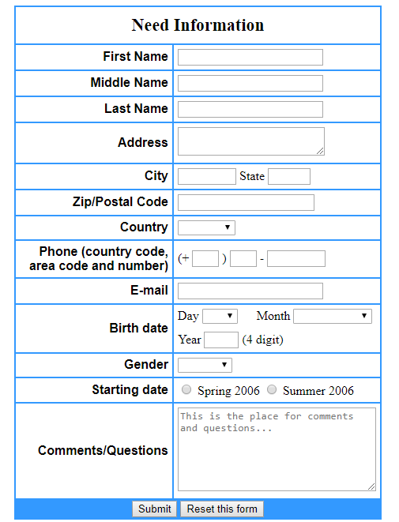
Form example
Input field
Text area
Select
Radio buttons
Submit button

Slide 50
Components
Form Name - specifies the name of a form
Form Action - specifies where to send the form-data when a form is submitted
Input Type - defines an input control
onClick - is an event handler

Slide 51
Code example
<form method="post">
Name: <input type="text" name ="name"/><br>
Email: <input type="text" name ="email"/><br>
Gender: <input type="radio" name ="gender"/>Male<br>
<input type="radio" name ="gender"/>Female<br>
Comments: <br>
<textarea name="comments">Any other comments?</textarea><br>
<input type="submit"/><br>
<form>
Type
Type of
input
Radio buttons
Textarea
Submit
button

Slide 52
$_GET[]
$_POST[]
PHP Forms
Form Handling

Slide 53
Form Handling
The PHP superglobals $_GET and $_POST are used to collect form-data:
$_GET is an array of variables passed to the current script via the URL parameters
$_POST is an array of variables passed to the current script via the HTTP POST method

Slide 54
Variable Handling Functions
Checking whether a variable exists
isset(variable)
Deleting an existing variable
unset(variable)
$count = 20;
if (isset($count))
echo $count; // 20
unset($count);
echo $count; // Notice: Undefined variable: count

Slide 55
htmlspecialchars()
Convert the predefined characters "<" (less than) and ">" (greater than) to HTML entities
<?php
$str = "This is some <b>bold</b> text.";
echo $str . "<br>";
//In the browser: "This is some bold text."
echo htmlspecialchars($str);
//In the browser: "This is some <b>bold<b> text."
?>

Slide 56
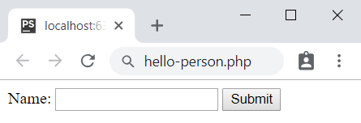
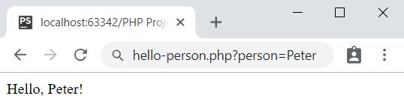
Problem: Hello, Person!
Write a program which receives a name from a form and prints in the html a greetings: "Hello, {name}!"
The form should disappear after clicking the input
Check your solution here: https://judge.softuni.bg/Contests/1200/

Slide 57
Solution: Hello, Person!
<?php
if (isset($_GET['person'])) {
$person = htmlspecialchars($_GET['person']);
echo "Hello, $person!";
} else { ?>
<form>
Name: <input type="text" name="person"/>
<input type="submit"/>
</form>
<?php } ?>
Check your solution here: https://judge.softuni.bg/Contests/1200/

Slide 58
Problem: Multiply Two Numbers
Write a PHP script that receive numbers num1 and num2, multiplies it and prints the result in the HTML page
The input comes as parameters named num1 and num2
Get the skeleton by the lab
num1 | num2 | Result
4 | 2 | 8
6 | 6 | 36
Check your solution here: https://judge.softuni.bg/Contests/1200/

Slide 59
Solution: Multiply Two Numbers
<?php
if (isset($_GET['num1']) && isset($_GET['num2'])) {
$num1 = intval($_GET['num1']);
$num2 = intval($_GET['num2']);
$result = $num1 * $num2;
echo $result;
}
?>
Check your solution here: https://judge.softuni.bg/Contests/1200/

Slide 60

Summary
Functions:
break large programs into simple functions that solve small sub-problems
consist of declaration and body
are invoked by their name
can accept parameters
Forms:
are used to enter data that is sent to a server for processing
the superglobals $_GET[] and $_POST[] are used to collect form-data
…
…
…

Slide 61
https://softuni.bg/courses/technology-fundamentals

Slide 62













SoftUni Diamond Partners

Slide 63





SoftUni Organizational Partners

Slide 64




Trainings @ Software University (SoftUni)
Software University – High-Quality Education and Employment Opportunities
softuni.bg
Software University Foundation
http://softuni.foundation/
Software University @ Facebook
facebook.com/SoftwareUniversity
Software University Forums
forum.softuni.bg

Slide 65

License
This course (slides, examples, demos, videos, homework, etc.) is licensed under the "Creative Commons Attribution-NonCommercial-ShareAlike 4.0 International" license

